Slide 1
ECS 271 Project
House Price Prediction
Team members: Kai Lan, Xiang Hao
Notes:
This is Xiang, we are the teammates doing this final project that is called House Price Prediction. Now, let me introduce you parts of components for this project first.

Slide 2
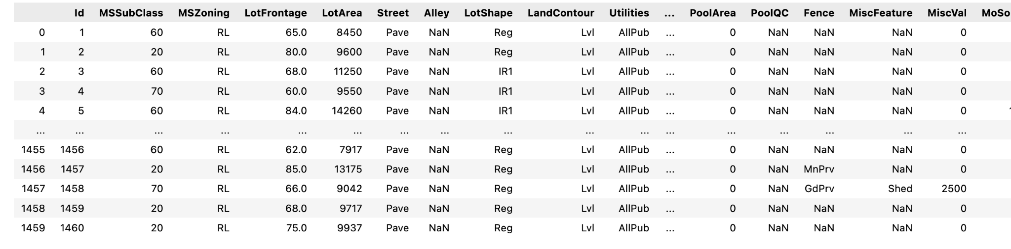
Data
1460 samples, 79 features, 1 output
After one-hot encoding, 305 features
Notes:
First is the data we used. Data processing: There are 1460 samples, 79 features, 1 output named Sale Price. After one-hot encoding, there are 305 features in total.

Slide 3
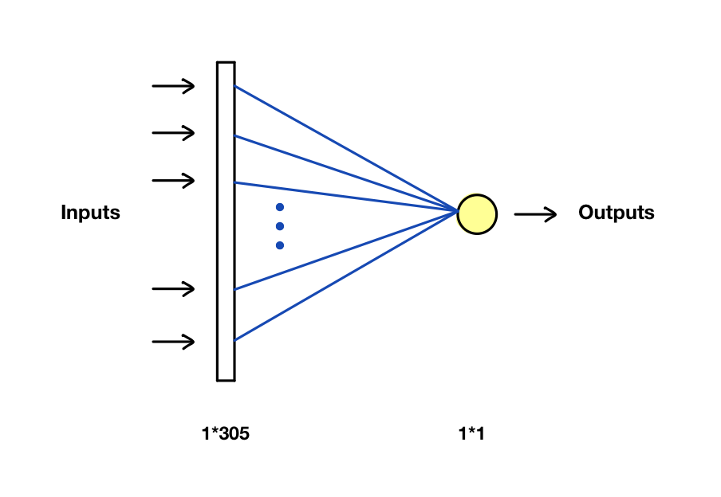
Base model - Linear Regression
It can be visualized as a one fully connected neural network with no nonlinear activation that takes a input vector that outputs a single value.
The best result was obtained with batch_size 1, and we trained for 50 epochs.
This is the basic model for our program.
Notes:
As you can see on the figure, linear regression is a basic model with one fully connected neural network with no nonlinear activation function. This is the basic model for our program.

Slide 4
Used Models but they are not working
1D - CNN
2D - CNN
Decision Trees
Notes:
There are three methods we used but didn’t work, the first one is One-dimensional convolutional neural network

Slide 5
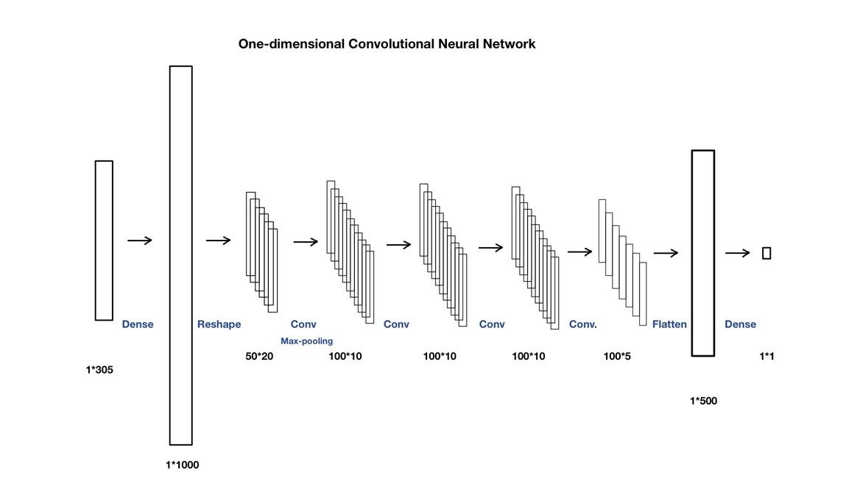
One-dimensional Convolutional Neural Network
Enriching and sorting feature sets,
Restructure the data
Notes:
We did enriching and sorting feature sets, and restructured the data in this model. We used Dense, reshape, Applies a 1D convolution, flatten functions here.

Slide 6
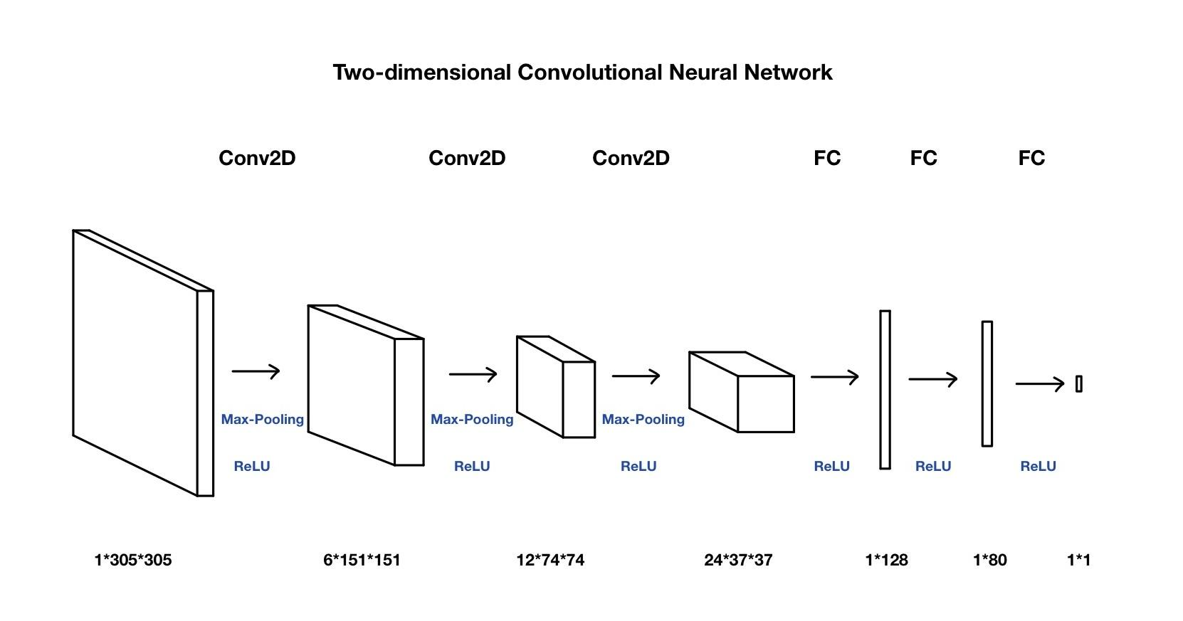
Two-dimensional Convolutional Neural Network
Outer product of 1D data
Notes:
And another one is Two-dimensional Convolution Neural Network, we used max-pooling and relu activation functions in this methods. After testing and deeply researching, we found Two-dimensional Convolution Neural Network method did not fit with the data we used here.

Slide 7
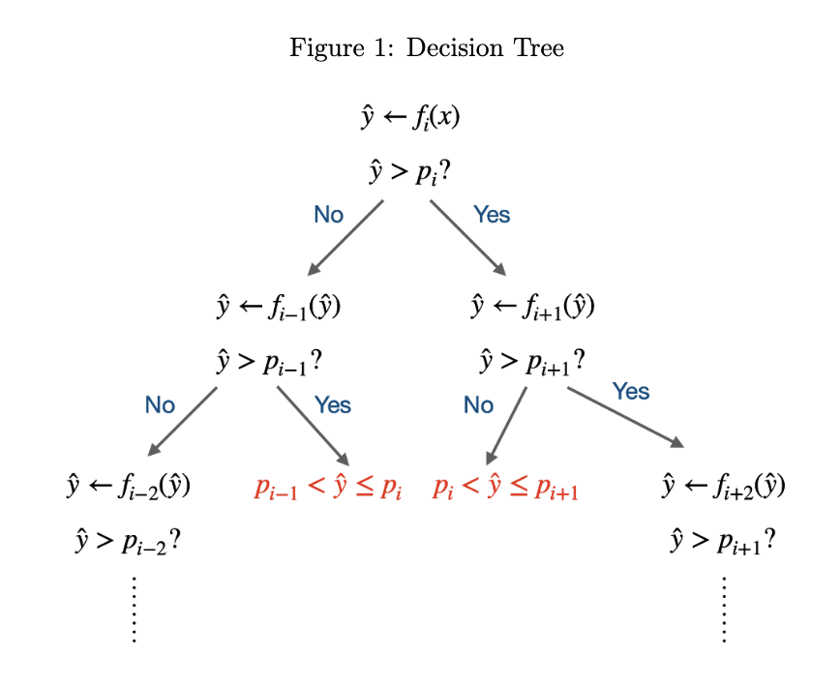
Decision Trees
Classification
Training multiple classifiers separately
Inference with a decision tree

Slide 8
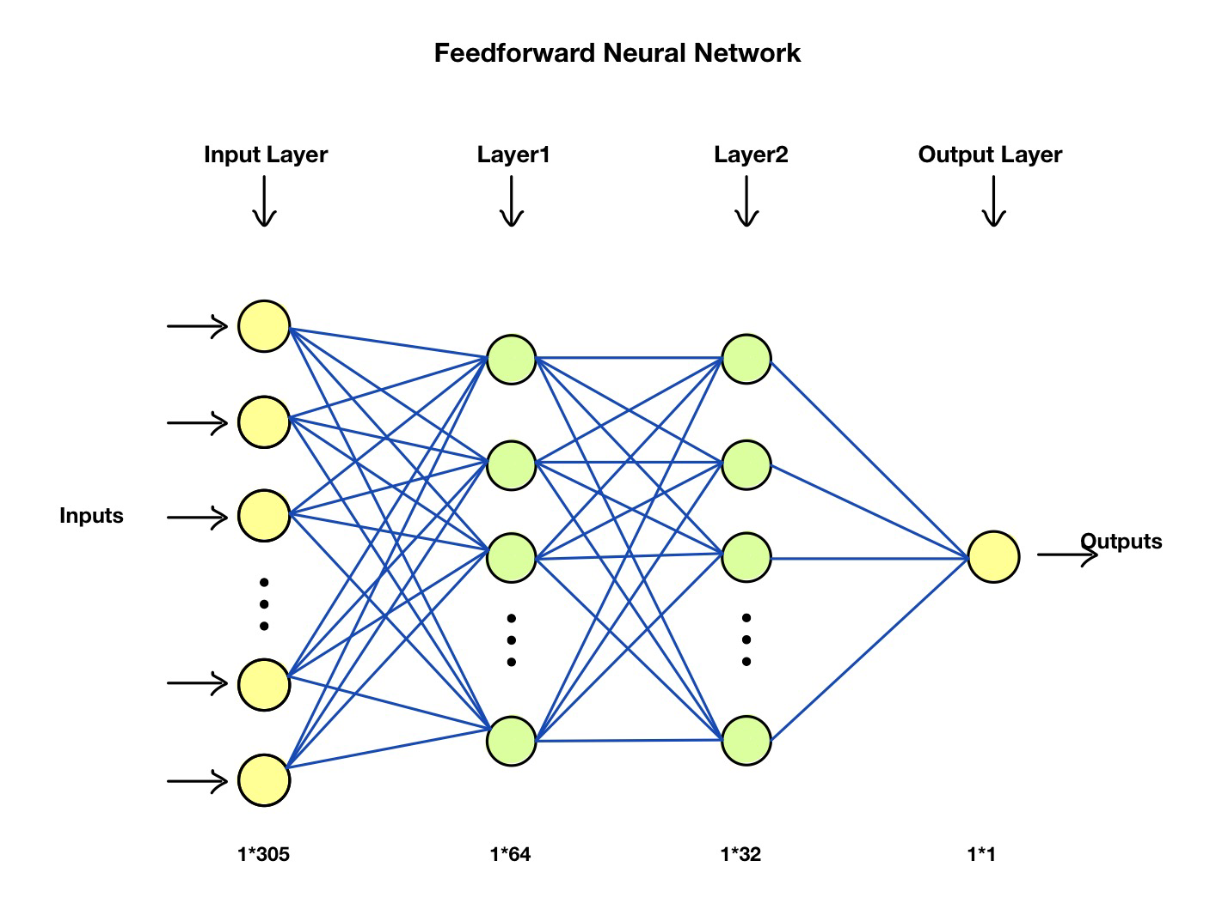
Model Used in our project - Feedforward Neural Network
No activation function required
Multilayer linear regressor
Tried Dropout and Batch Normalization

Slide 9
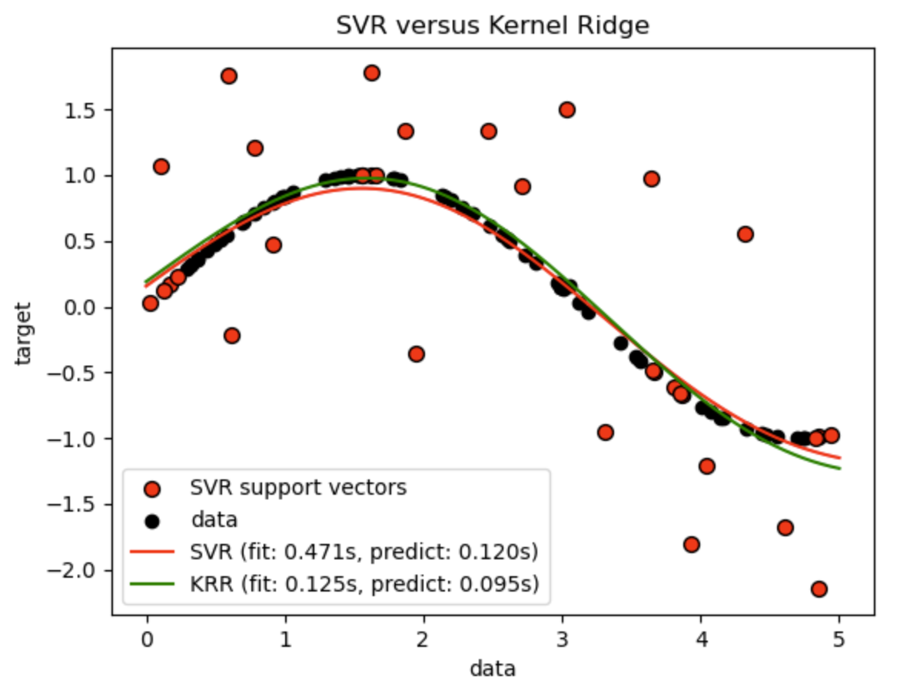
Kernel Method
Data fitting with nonlinear function
For small to medium sized problem, fast to solve directly
For larger scale using iterative implementation
Polynomials are one type of kernel

Slide 10
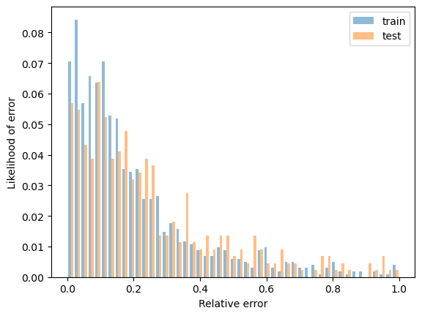
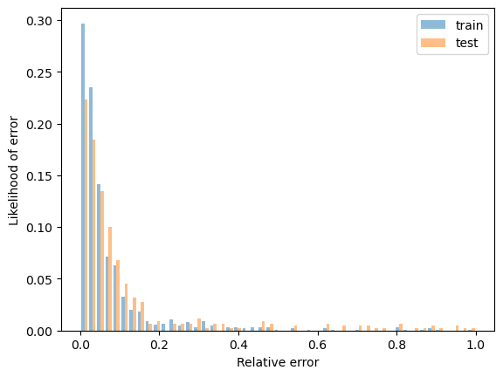
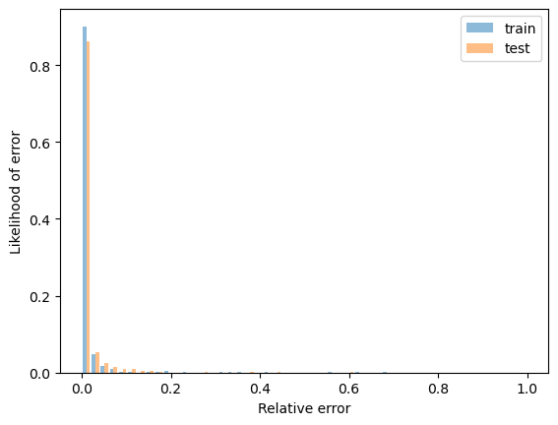
Error distribution
Linear Regression
Feedforward Neural Network
Kernel

Slide 11
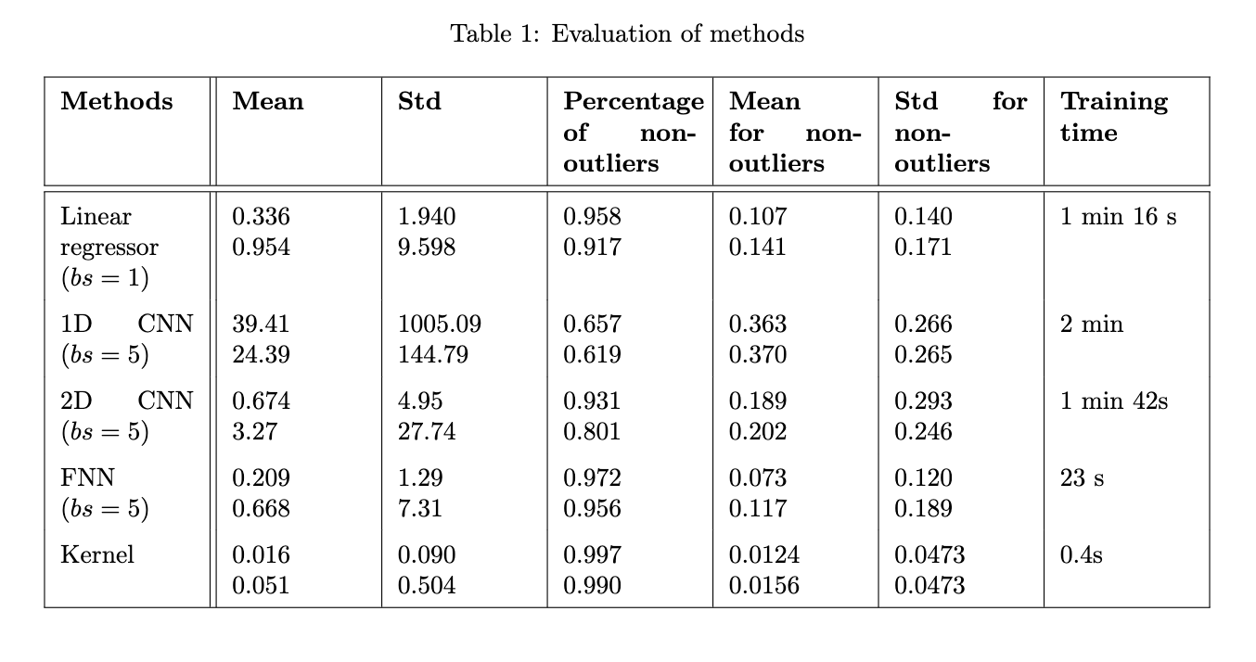
Results of Model using different methods
Notes:
Benchmarks

Slide 12
Thanks for watching

